Slide 1
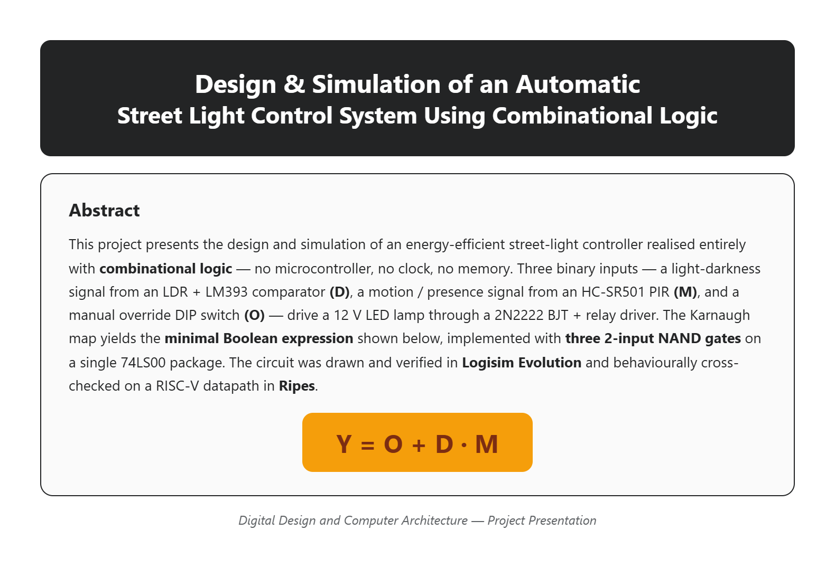

Slide 2
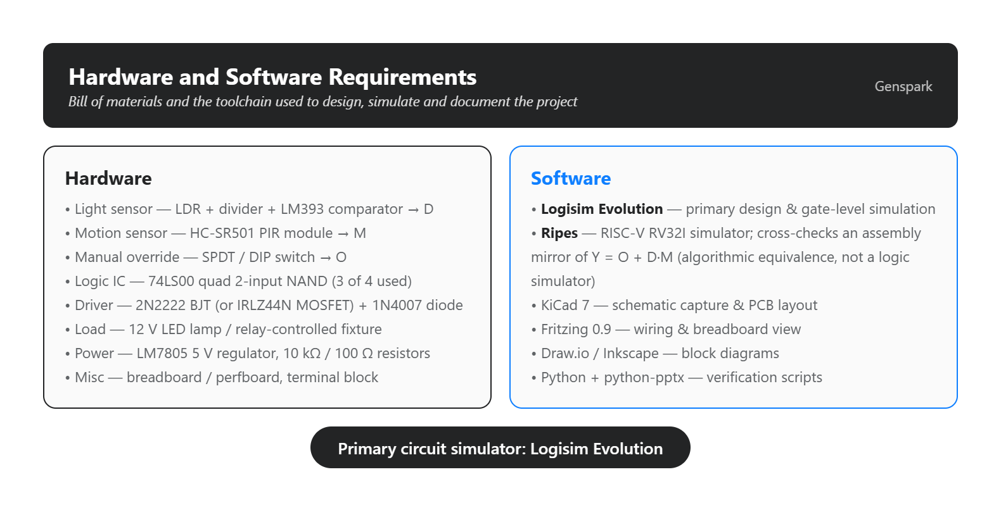

Slide 3
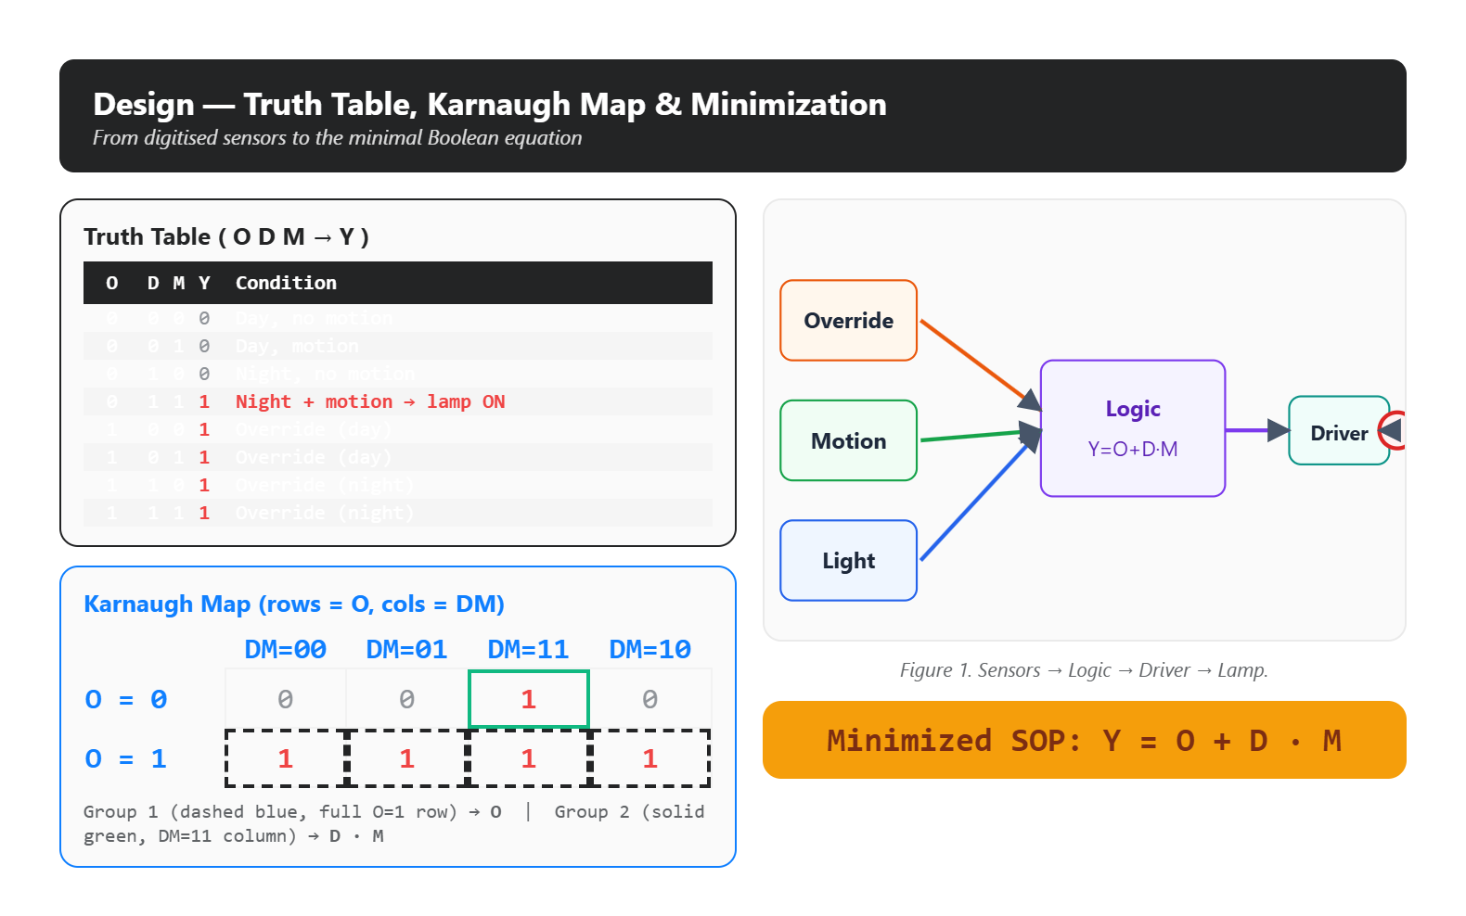
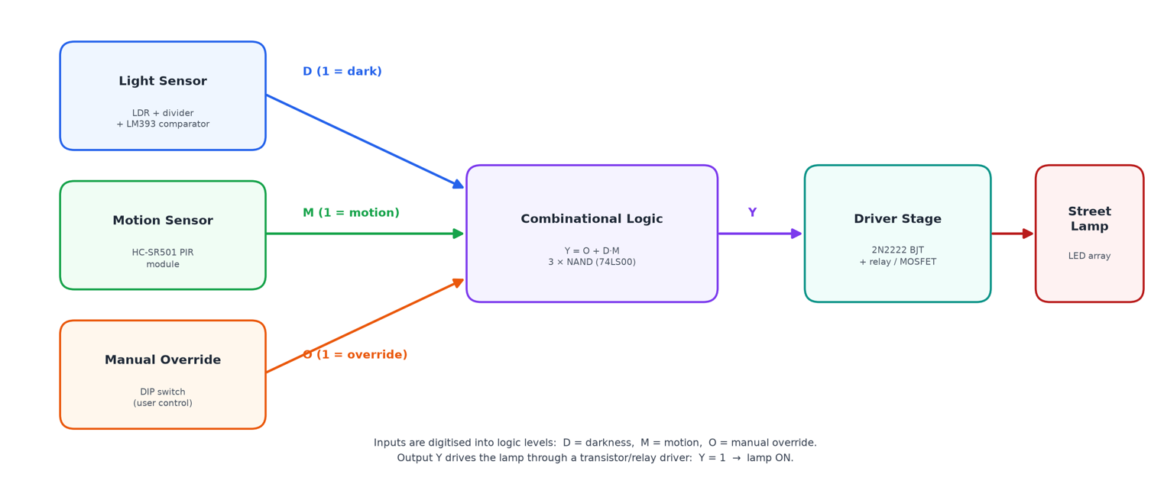
O | D | M | Y | Condition
0 | 0 | 0 | 0 | Day, no motion
0 | 0 | 1 | 0 | Day, motion
0 | 1 | 0 | 0 | Night, no motion
0 | 1 | 1 | 1 | Night + motion ← lamp ON
1 | 0 | 0 | 1 | Override (day)
1 | 0 | 1 | 1 | Override (day)
1 | 1 | 0 | 1 | Override (night)
1 | 1 | 1 | 1 | Override (night)
 | DM=00 | DM=01 | DM=11 | DM=10
O = 0 | 0 | 0 | 1 | 0
O = 1 | 1 | 1 | 1 | 1

Slide 4
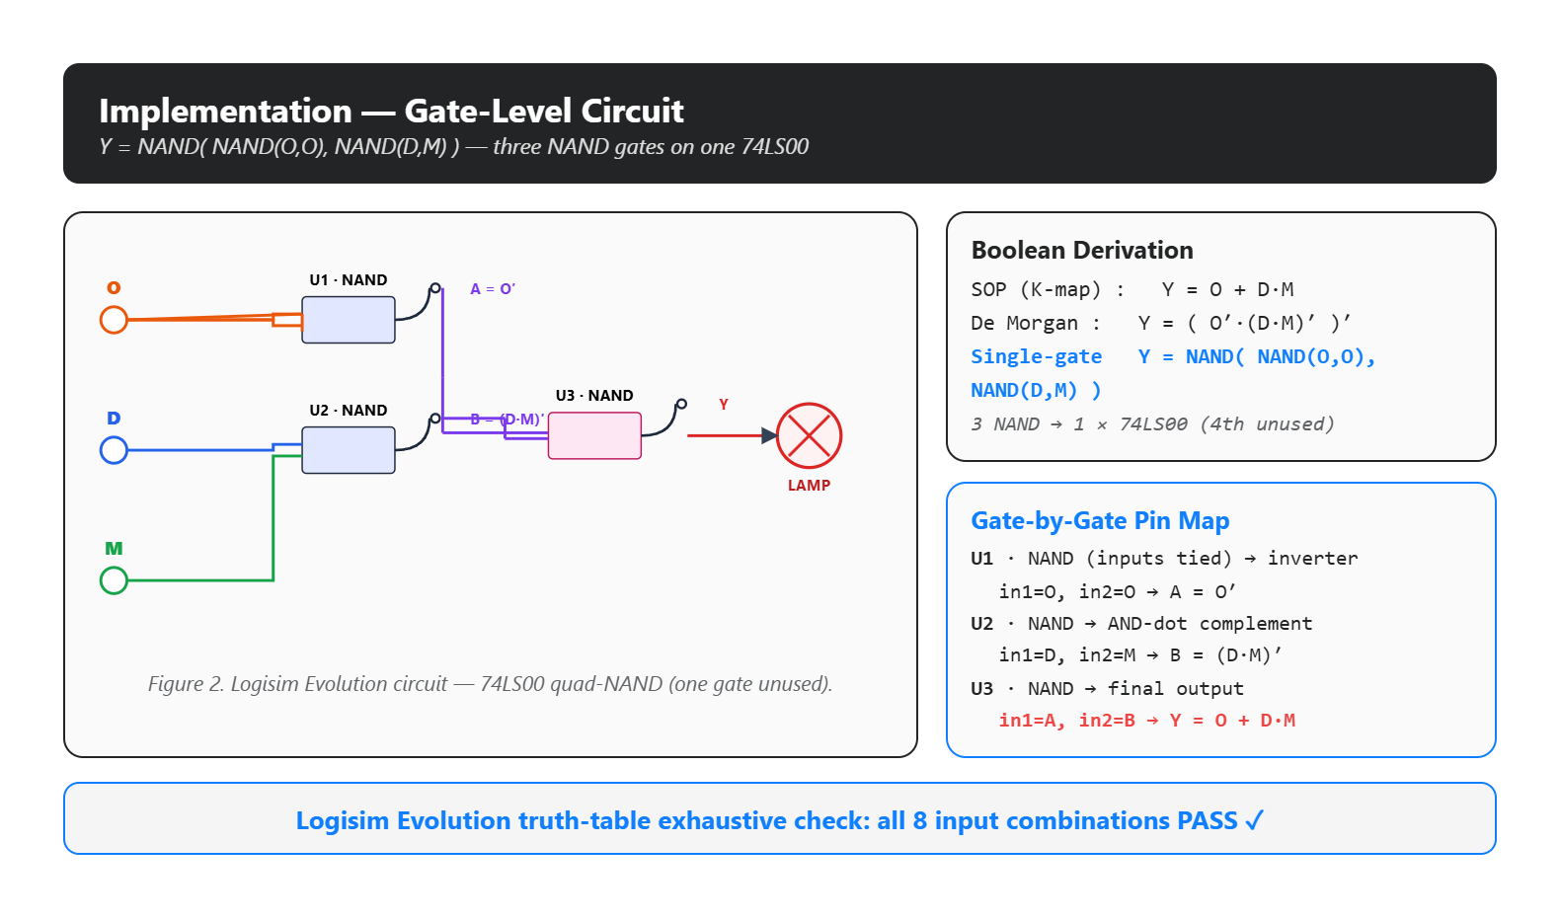
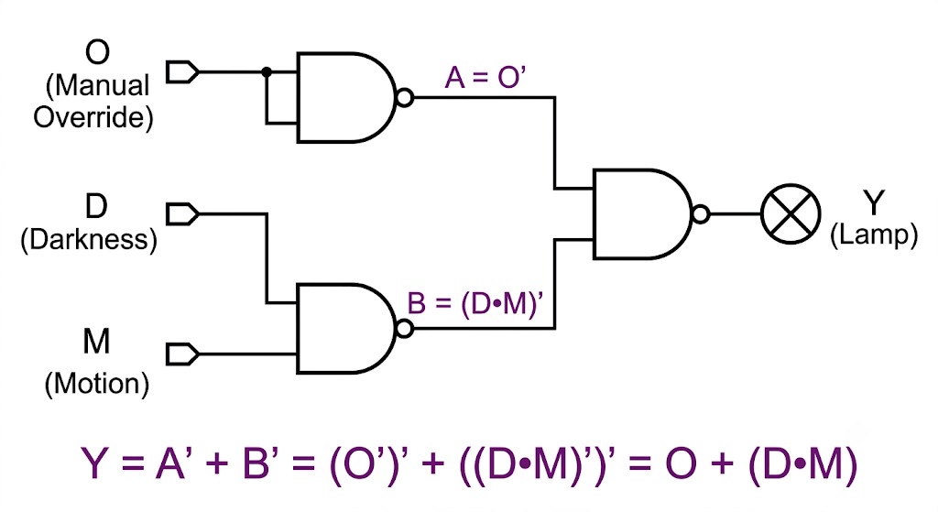

Slide 5
